Slide 1
Project Name :E-Commerce Website “Nursery”
Project Members:
Mangesh Sawalkar(TL) Dipak Mani Akash Sonwane | 210543181093 210543181023 210543181005
Saurabh Shastri | 210543181096

Slide 2

Objective:
This project is a web based online Plant shopping system. The project objective is to deliver the online plant shopping website. Online shopping is the process whereby consumers directly buy Different types of plants without an intermediary service, over the Internet. It is a form of electronic commerce. This project is an attempt to provide the advantages of online shopping to customers. It helps buying the products anywhere through internet. Thus the customer will get the service of online plant shopping and home delivery from this website.

Slide 3

Flow :
When user will open the website then firstly , home page will be displayed to him from which user can act according to their preference.
User can purchase according to their availability and
requirement.
After registration User will login and
User will be able to add the product into the cart and then place the order . But User will be register first otherwise the order not adding to cart.
User can click on the cart for see the details of ordered product which they have ordered.
User can also update their proﬁle details.
•
•
•
•
•

Slide 4
Admin :
Admin can regulate all functionality
Admin will login to the portal or will have to register if he is not a registered Admin.
Admin can verify an approve seller can add and edit products details.
Admin can manage users details and manage orders.

Slide 5
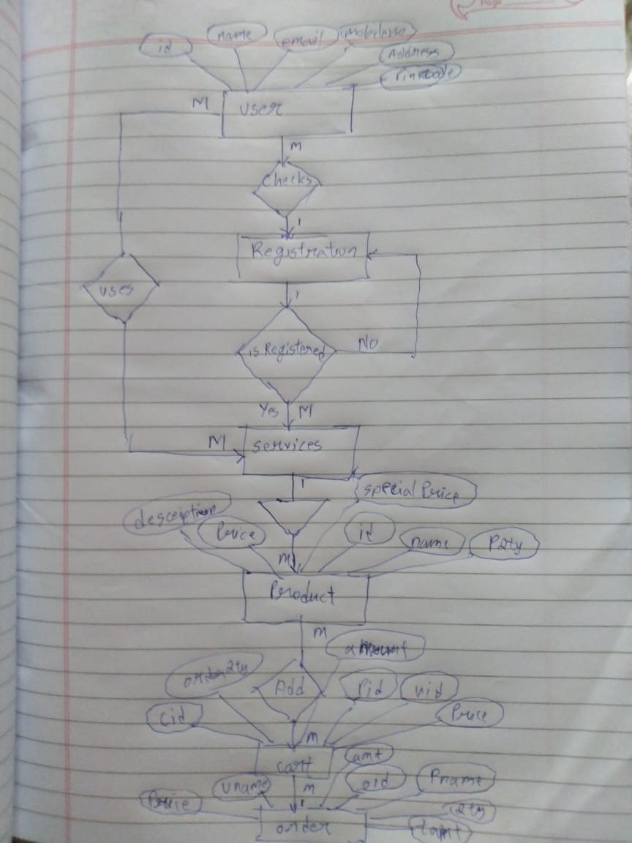
Flow diagram:

Slide 6

Schema:
1) Table name –user_register
userid,dob,email,fname,gender,lname,upassword
2) Table name : cart
id, prodId,product_name, product_qty,rate,userid,customer_userid,product_prodid
Table name : Category catid,catimage,catname
Table name : order_details id,orderid,price,proid,qty,order_id,product_id
Table name : orders id,bill_addr,cartno,orderdate,ship_addr,status,userid
Table name : product:
proid,catid,pic,pname,price,product_description,qty,category_catid
7) Table name : Admin_User
userid .

Slide 7
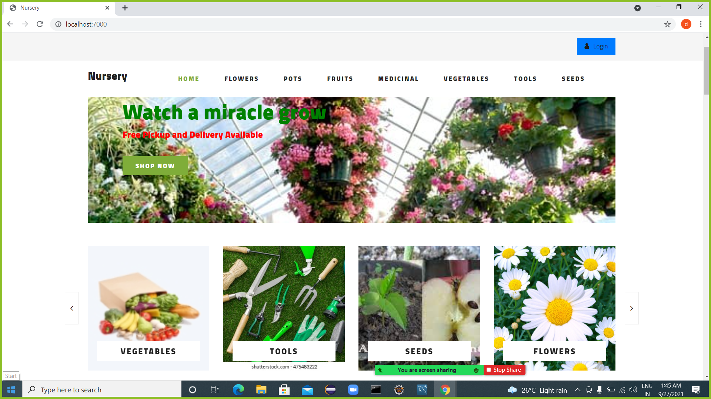
Home Page:

Slide 8
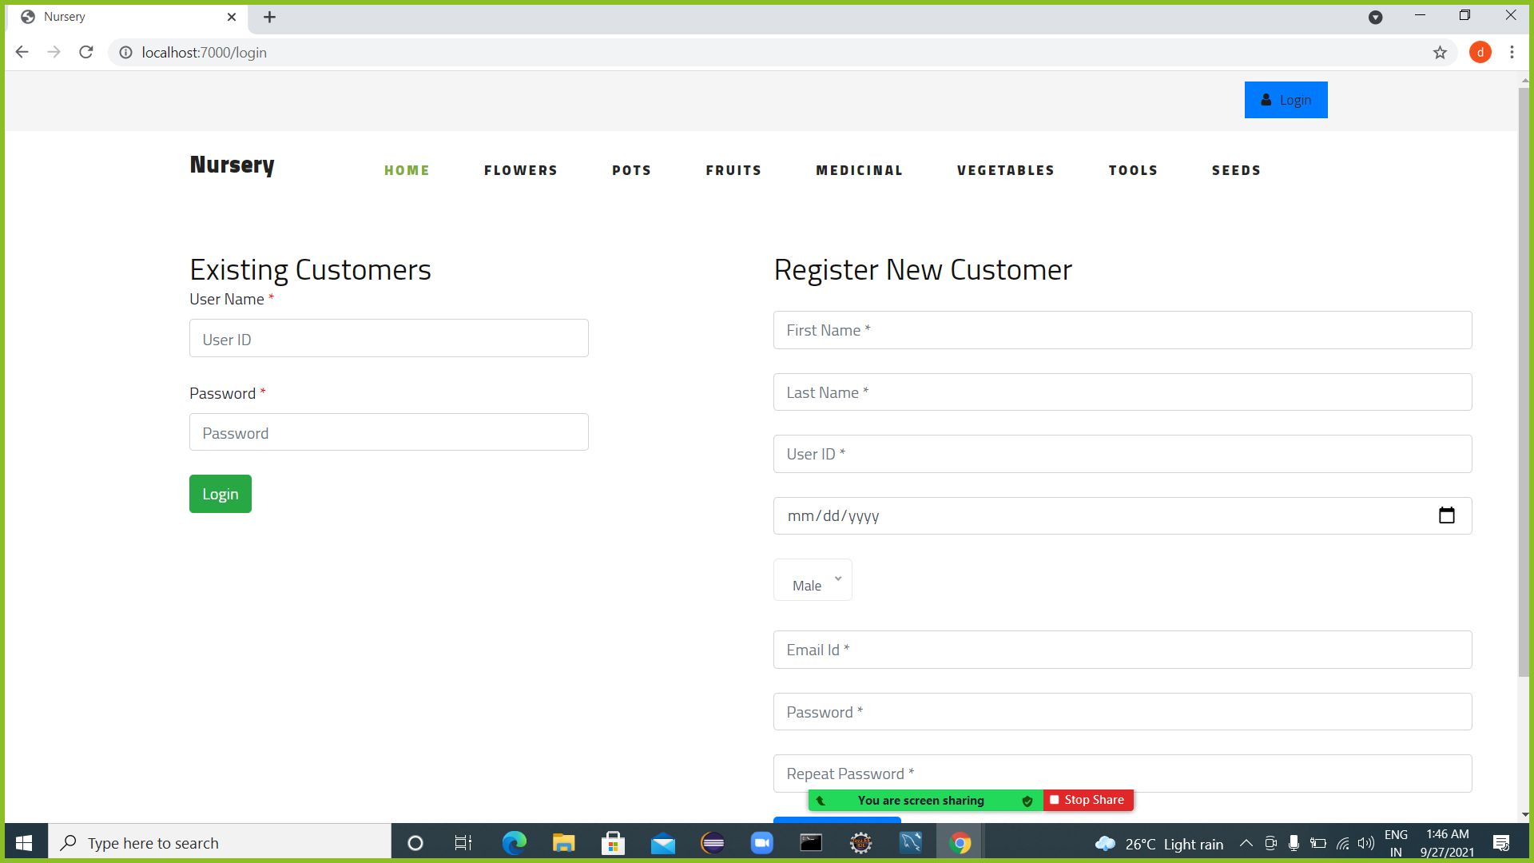
Registration Page:

Slide 9
Login Page:

Slide 10
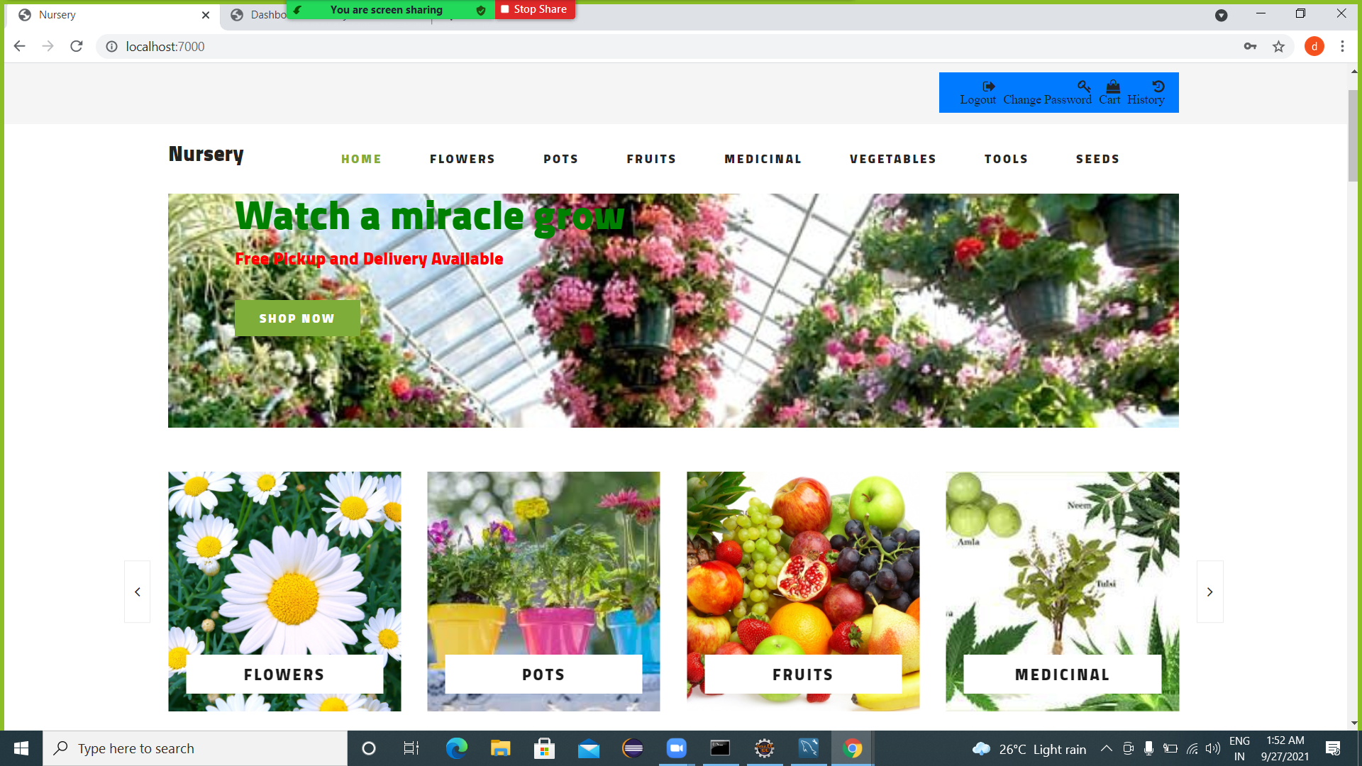
User Registration:

Slide 11
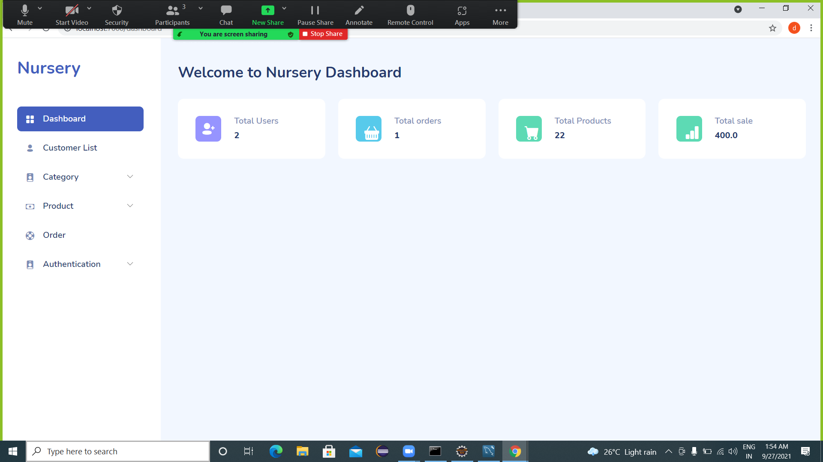
Dashboard:

Slide 12
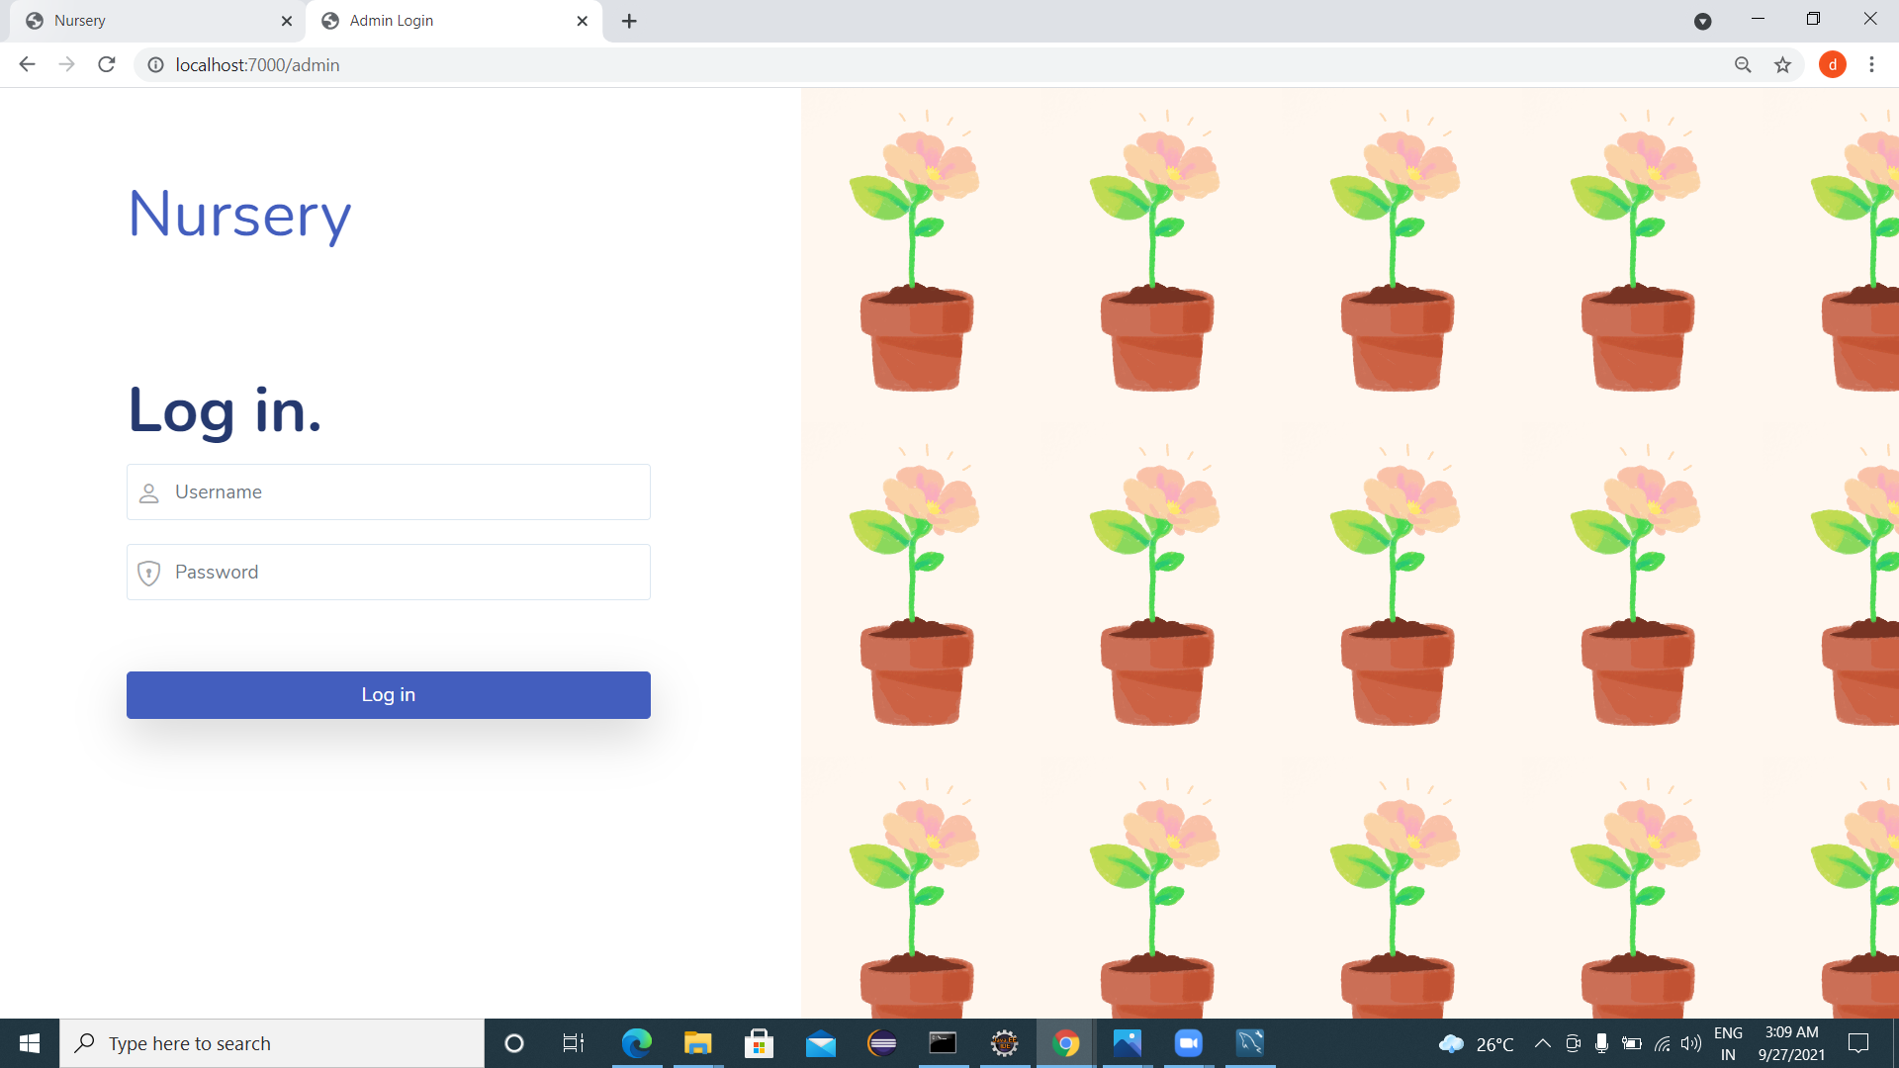
Admin Page:

Slide 13
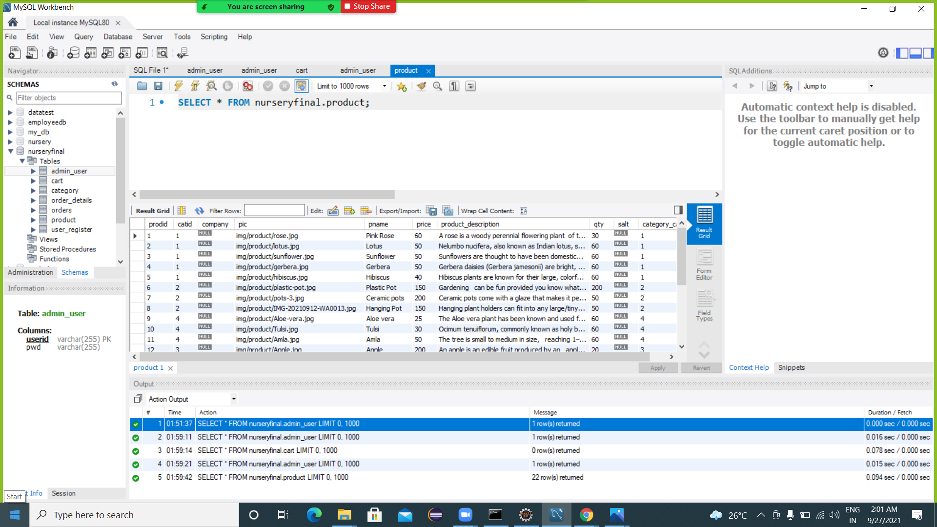
Product Output:

Slide 14
Future Scope of Project:
Add Filters
Searching Bar
Registration Using Mobile Number OTP.
User will be able to track their order using google map.
User will be able to register using geo location.

Slide 15

Conclusion:
Hence We Provided Easiest Way For Plant Shopping that is online E-Commerce Website.

Slide 16
Thank You.

